Slide 1

A Case Study
on
Leaf Area Index Estimation from drone based top-of-the-canopy digital Images
by
Rahul Raj
Research Scholar CSRE, IIT Bombay IITB-Monash Research Academy

Slide 2
Overview of the series of two lectures
Understand the method
How to separate the various classes from an Image
Apply the technique on Images (Hands-on)
You will be given few top-of-the-canopy images collected from a drone based digital camera. You will be asked to find gap fraction and LAI value of the area captured in that image.
How to collect drone-based canopy images and its ground-truth
How to find gap fraction and its relationship with LAI
How to compare the results with ground-truth LAI data

Slide 3
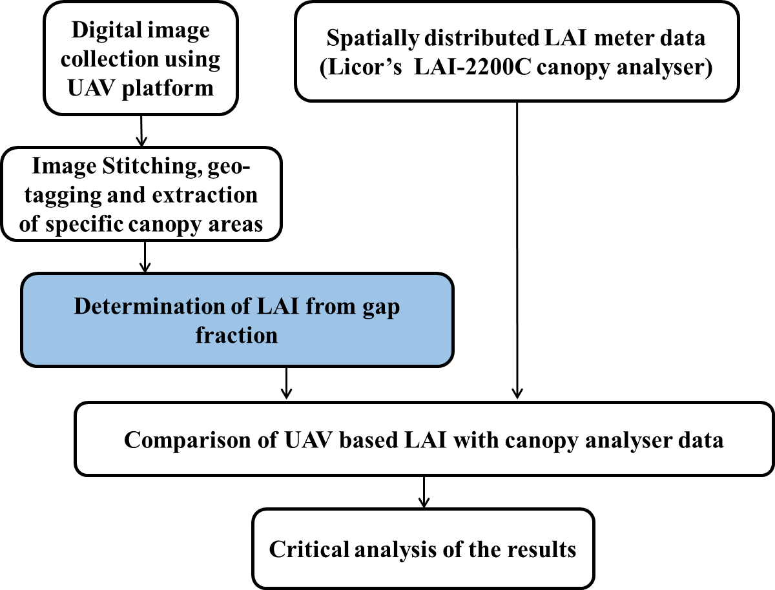
Flowchart of the study

Slide 4
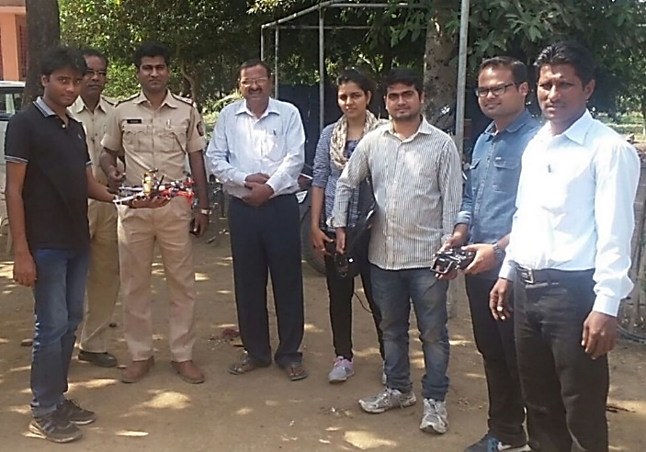
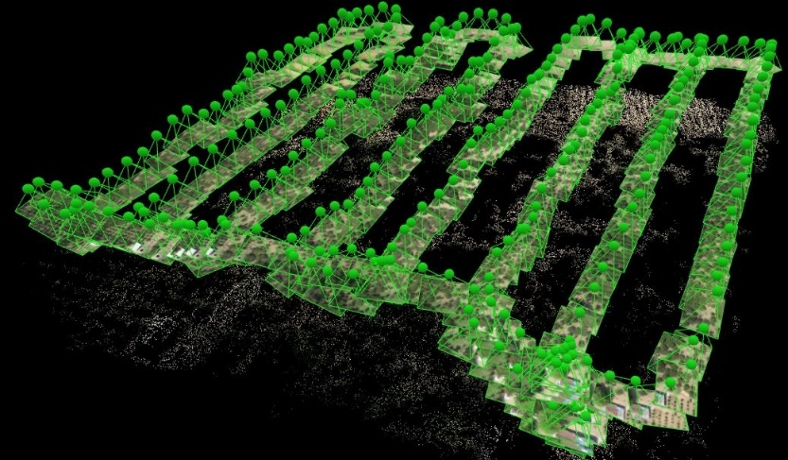
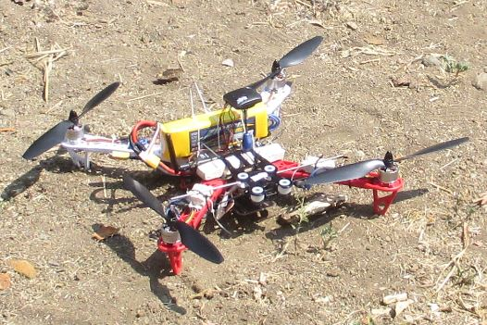
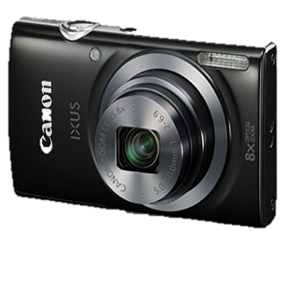
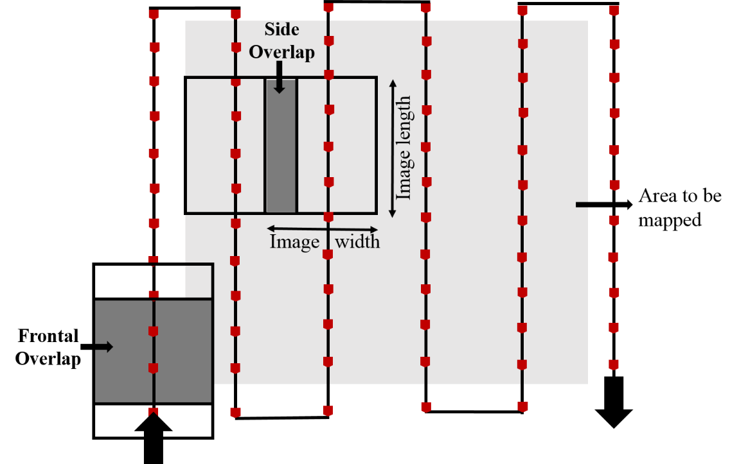
Collection of Drone based top-of-the-canopy images
Height
Time
Frequency
Angle
Overlap
Image
Type
Spatial
Resolution

Slide 5
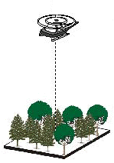
Collection of Drone based top-of-the-canopy images
Find the area captured by an image and its spatial resolution if following are known:
Height of drone: 25 meter
FOV of camera: 45 x 60 degree
Pixel count in X direction: 1024
Pixel count in Y direction: 1280
Flight Direction
Y
X
Notes:
Give question on Fov and Ifov

Slide 6
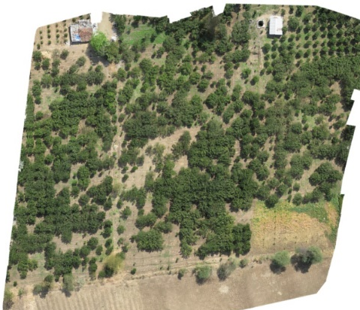
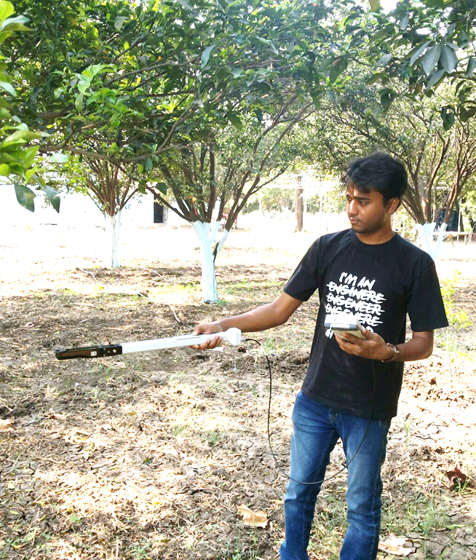

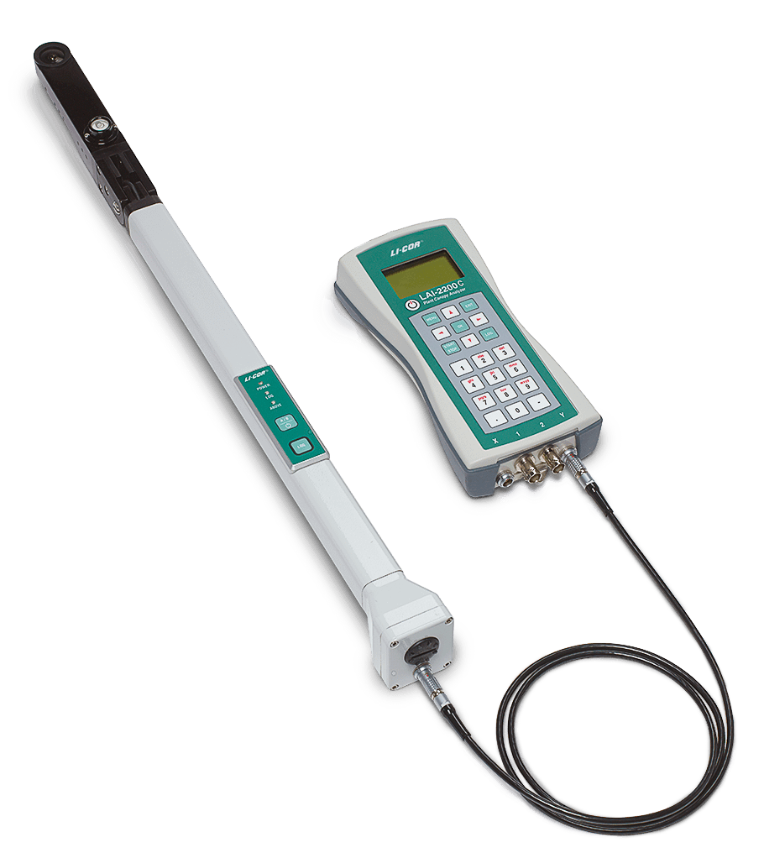
Stitched map of a citrus farm (Amravati, Maharashtra)
Ground truth LAI data collection
The orthomosaic map of the citrus farm is created by using 265 images collected from a drone based camera, flying at a height of 25 meters from ground

Slide 7
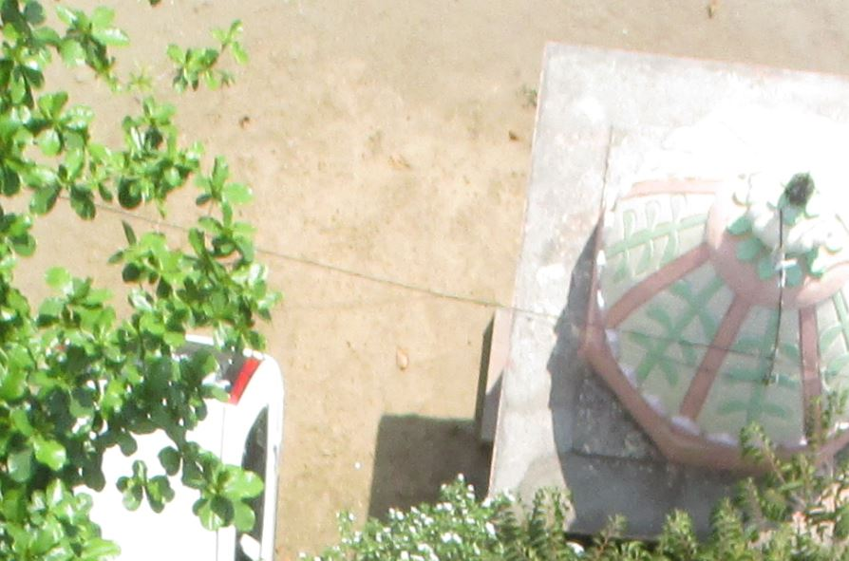
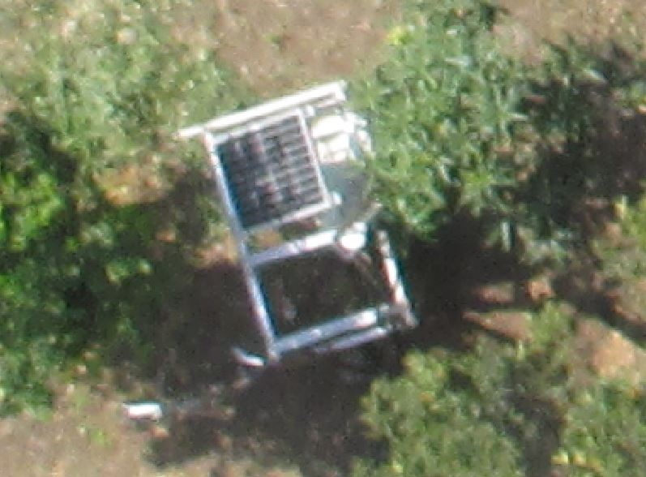
Stitched map of a citrus farm (Amravati, Maharashtra)
The orthomosaic map of the citrus farm is created by using 265 images collected from a drone based camera, flying at a height of 25 meters from ground

Slide 8
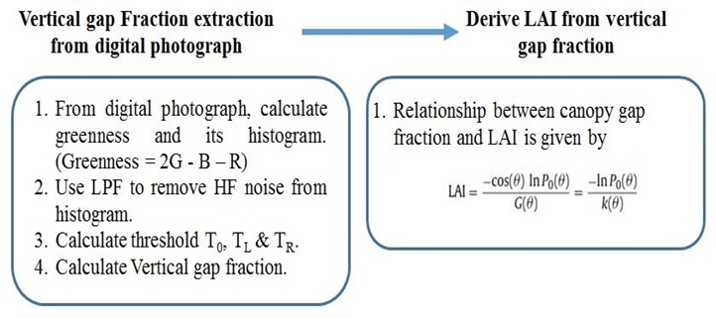
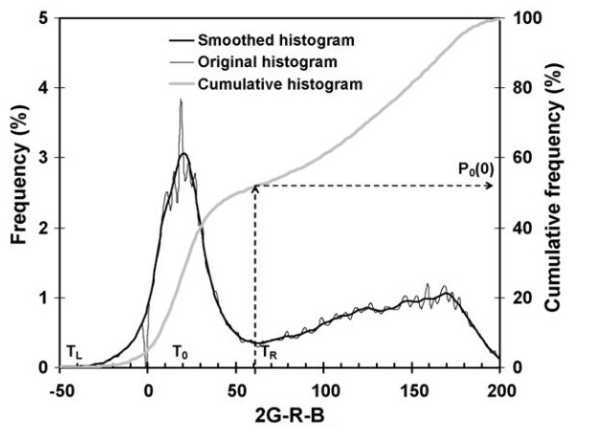
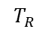
Estimation of gap-fraction and LAI from canopy images
P₀(ϴ) : Gap fraction in view or solar zenith angle ϴ.
G(ϴ) : Foliage projection coefficient for the plane perpendicular to direction ϴ
K(ϴ) : Canopy Extinction Coefficient.
Source: Paper on “Retrieval of leaf area index from top-of-canopy digital photography over agricultural crops’ by J. Liu and E. Pattey.
$$T_{R}$$
is an important point (first minima of curve) as it separates green and non green pixels. Minima is a point whose left and right side values are greater than its own value
Gap fraction is representation of density of green crop canopy. i.e. how much percentage of ground area is not covered with leaves when seen from above the canopy. Higher the gap fraction, lower the green canopy density.

Slide 9
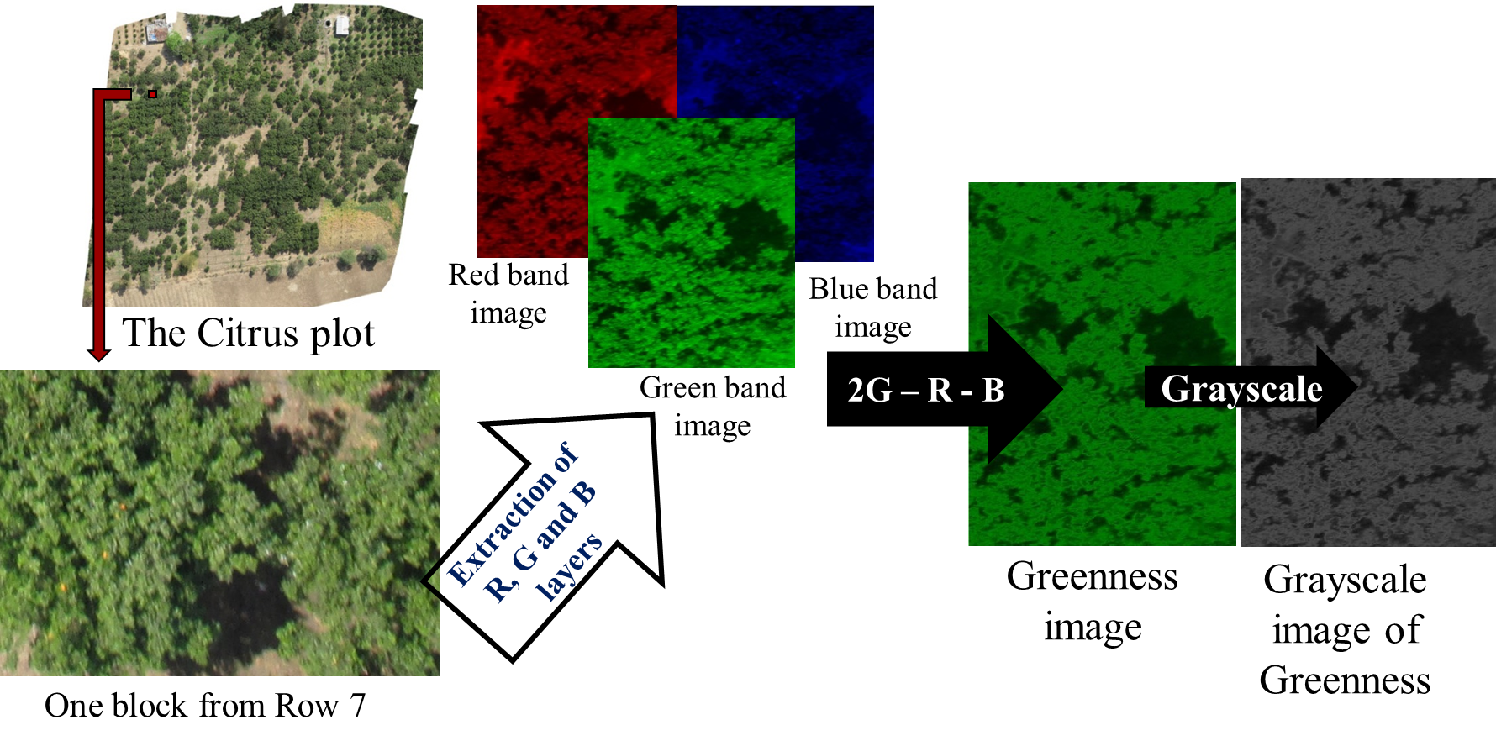
Extraction of Area of interest from the image and convert it to grayscale
From same place in the citrus plot, the ground truth LAI is also collected

Slide 10
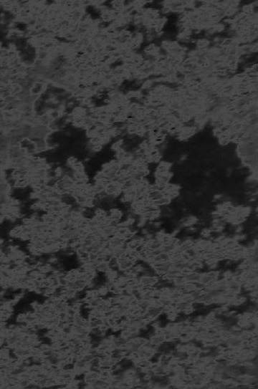
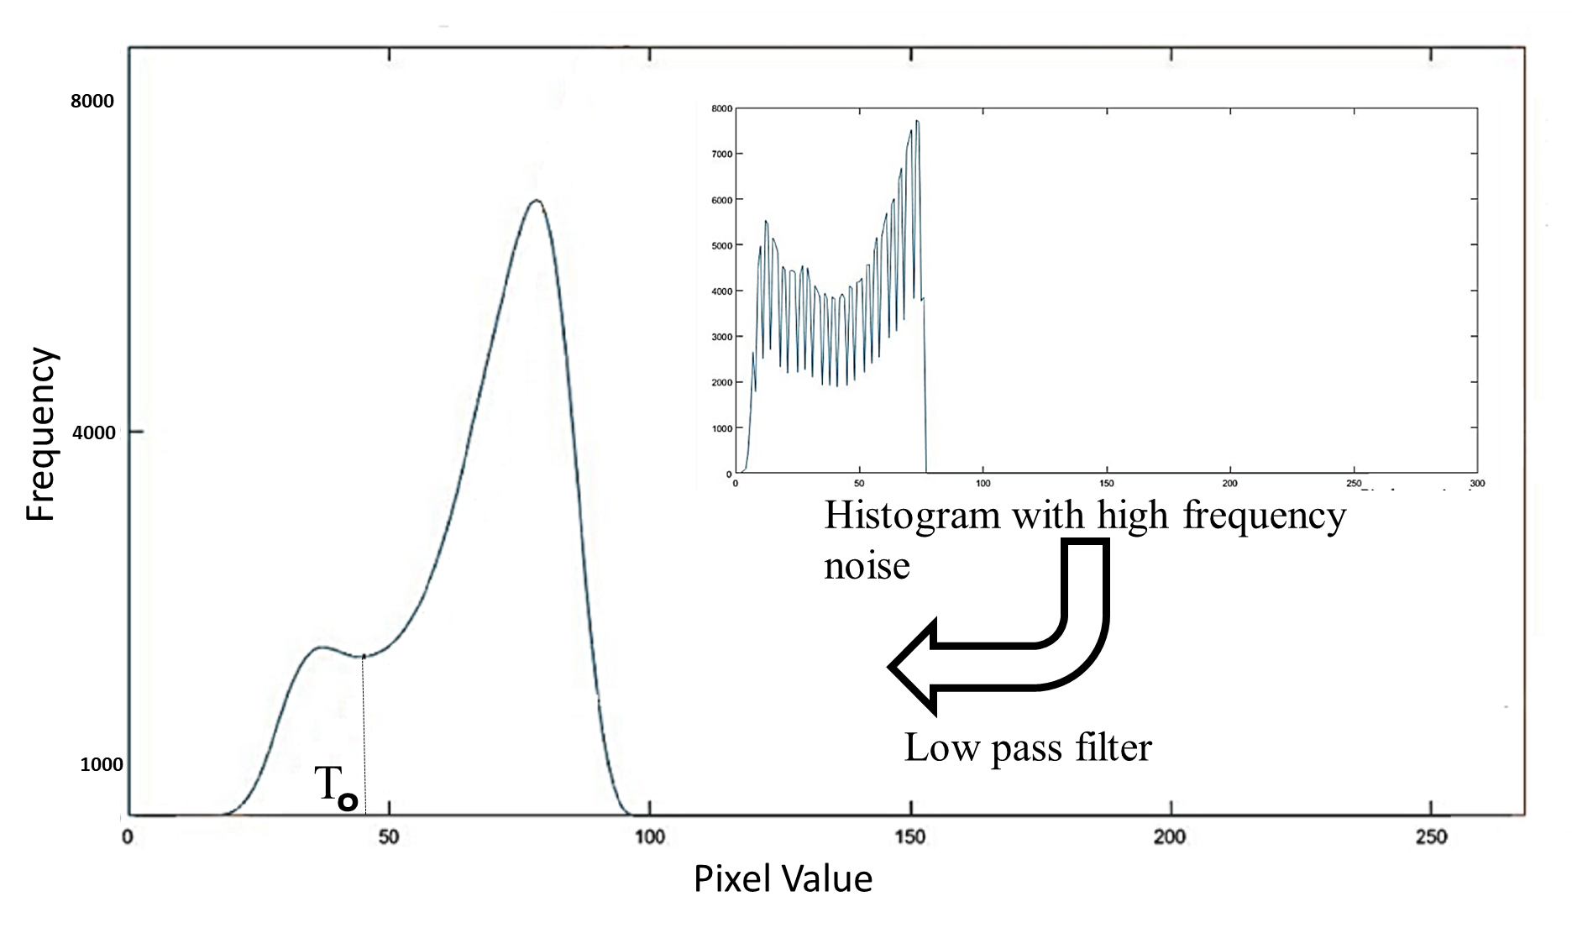
Histogram of grayscale image
Where are the two classes ???
Gap Fraction = ???

Slide 11
Histogram of grayscale image
Where are the two classes ???
Gap Fraction = (Number of pixels left to T0) / Total number of pixels in the histogram
LAI = -ln(Gap_fraction) / k
Notes:
Give some example

Slide 12
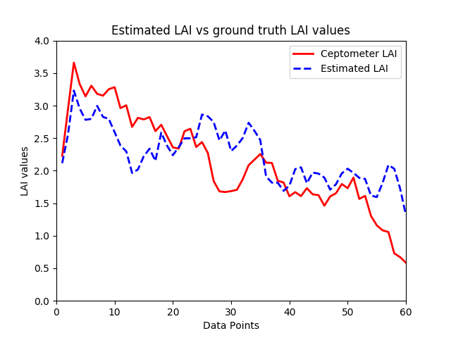
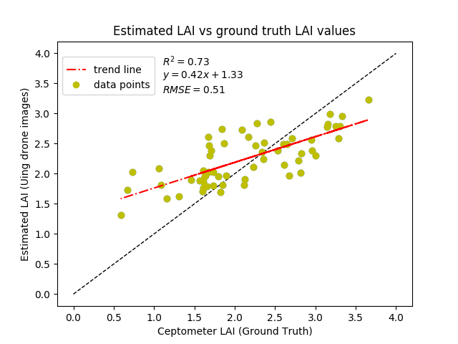
Analysis of Results

Slide 13
Analysis of Results
When GT-LAI > 3, estimated LAI is underestimated but the increase/decrease change trend remains the same
When the GT-LAI < 1.5, estimated LAI is overestimated, and even the increase/decrease change trend is not maintained.
The difference in LAI values is also because, the area of the cropped image (cropped from orthomosaic layer) will always be different from the area that is seen by the fisheye lens of the ceptometer; this is because the ceptometer view area is in the shape of a triangle, while the cropped images are approximated to a rectangular shape
Limitations
Effect of background pixel due to its color also contributes to error (for example, weed, green plastic and such others)
Otsu’s method only works when the two classes are having comparable number of pixels. It will not work for very open or high dense canopy
It is also difficult to fly the drone at a constant height with a constant speed and angle (due to changing wind conditions), which, sometimes, blurs the image pixels. To reduce this blur, the drone should fly at a low wind condition, and different flight paths and directions should be used while collecting the images from multiple flights

Slide 14
Solve the following:
Find LAI of the below image. Pixel value less or equal to ‘15’ represents background and above ‘15’ represents leaf.
1 | 2 | 52 | 45 | 54 | 35 | 89 | 32 | 36 | 1 | 25
2 | 1 | 3 | 21 | 56 | 1 | 2 | 3 | 35 | 34 | 36
3 | 3 | 65 | 21 | 21 | 3 | 23 | 25 | 45 | 2 | 1
15 | 11 | 56 | 2 | 13 | 79 | 13 | 56 | 1 | 2 | 23
25 | 1 | 2 | 12 | 23 | 54 | 23 | 62 | 33 | 13 | 13
35 | 75 | 45 | 1 | 2 | 1 | 2 | 42 | 33 | 1 | 1
40 | 1 | 28 | 78 | 3 | 68 | 21 | 1 | 2 | 56 | 45
2 | 3 | 54 | 54 | 77 | 5 | 46 | 36 | 12 | 2 | 1
45 | 2 | 35 | 14 | 25 | 36 | 45 | 35 | 1 | 2 | 3
2 | 1 | 25 | 1 | 2 | 45 | 1 | 2 | 36 | 56 | 64
3 | 3 | 65 | 3 | 3 | 65 | 56 | 3 | 36 | 24 | 68
Notes:
Gap fraction = (#pixel_value<=15)/total#pixels = 58/121 ; LAI = 1.47

Slide 15
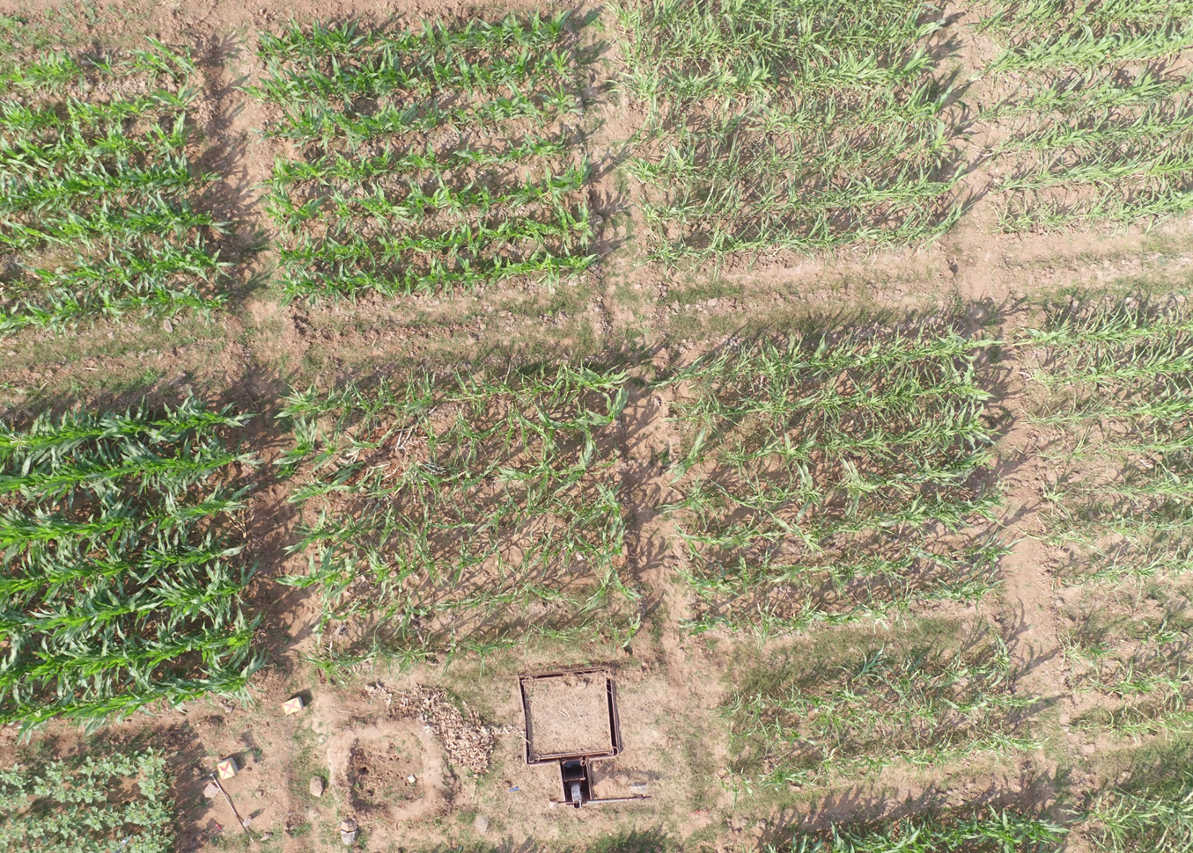
What does LAI actually represent

Slide 16
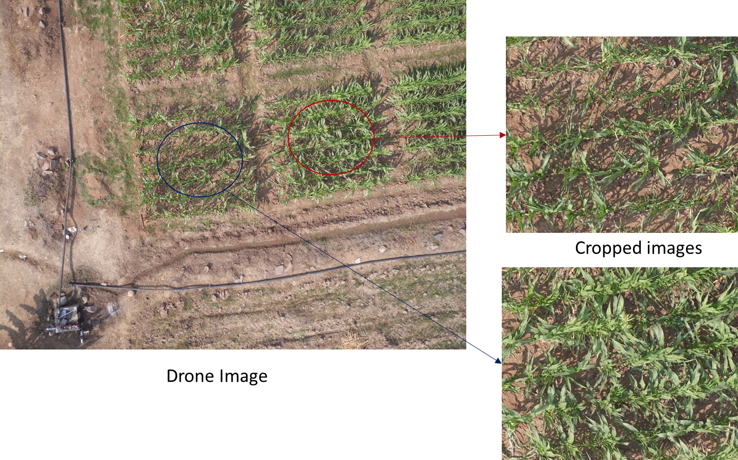
Find the LAI of these images

